Slide 1
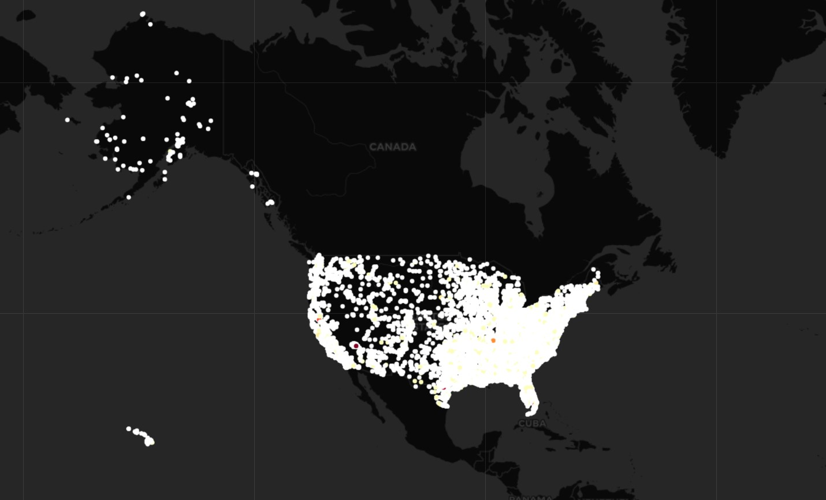
Gun violence in the USA

Slide 2
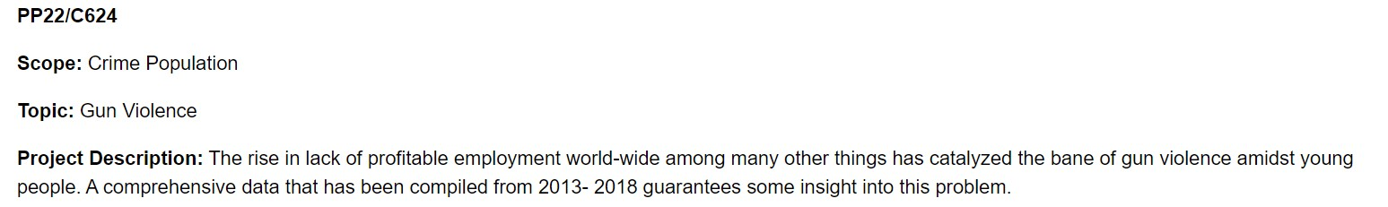
Problem Definition
This exploratory analysis would seek to draw insights from the frequencies of gun violence across states in the US. The age group mostly involved in the violent act, common places of occurrences of the violence, gender and relationship status of the participants.

Slide 3
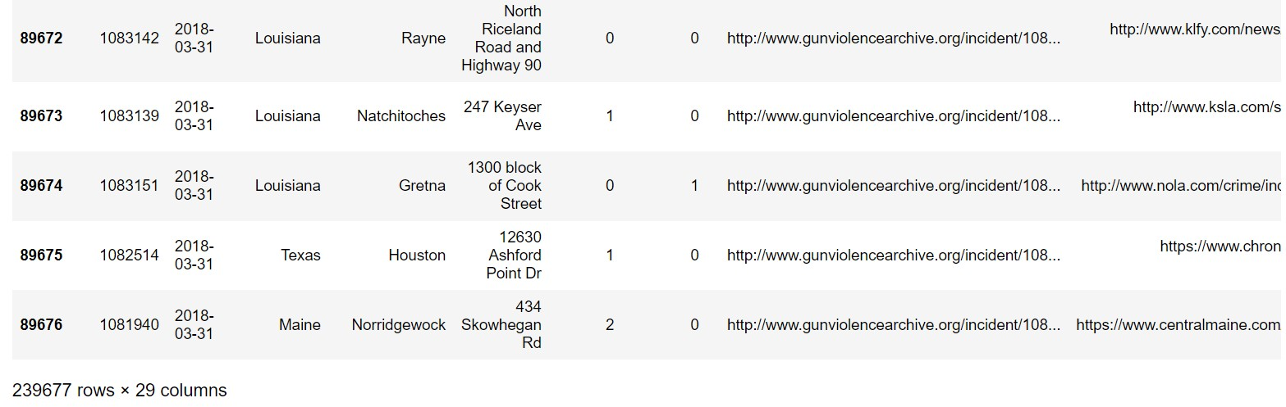
Data Frame
We have around 200k+ data points and 29 columns so we have sufficient data for the analysis

Slide 4
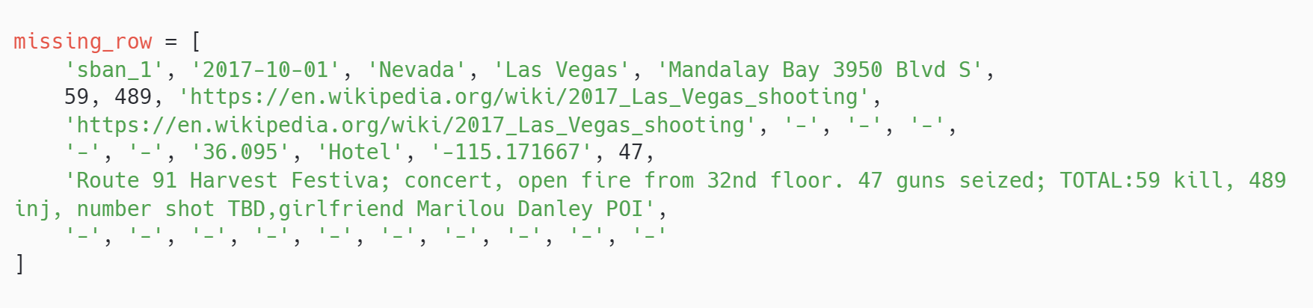
About the missing incident
We have found that there is a missing row in the data
to fix this row in the dataset
according to the author of this dataset, one particular incident is missing from the dataset
So we have manually added this incident.

Slide 5
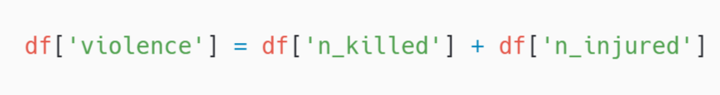
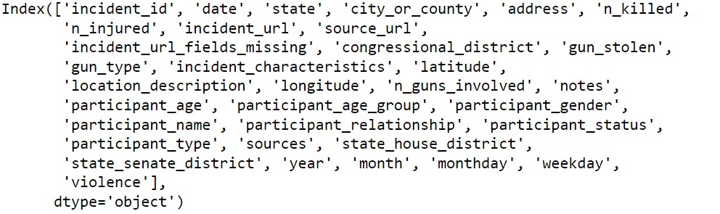
To get the number of violence is happening or not let’s combine the number of killed people and number of injured people
We have good number of columns .
Have split the date into year , month , month day, weekday do that it'll be helpful for the further analysis

Slide 6
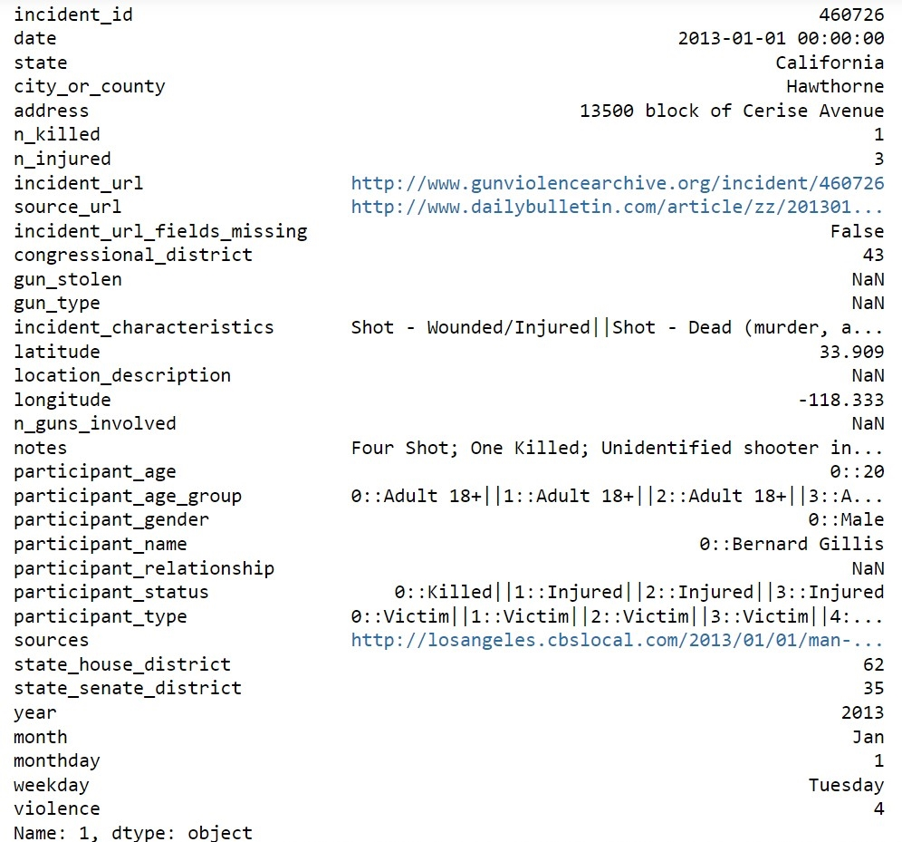
What does the row represent?
a piece of data

Slide 7
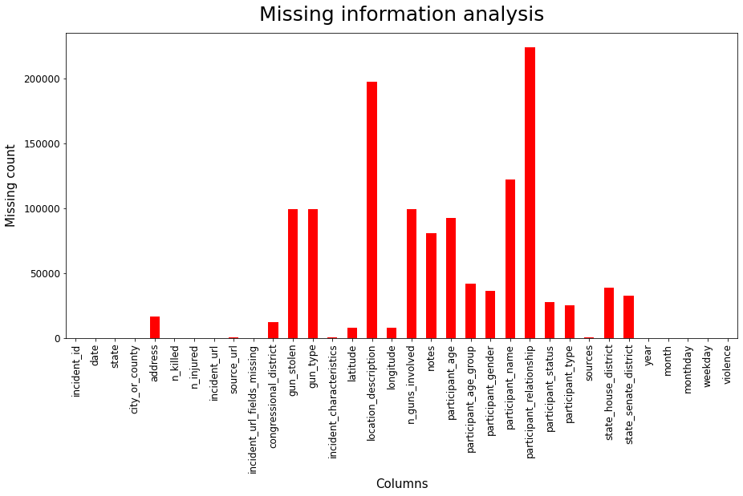
Analysing the null information in the data
As we can see that we have a lot of missing data but for the analysis we requires date ,killed, injured and the place.
So here they are not absent
Why we have this much missing data ?
Reason is simple this dataset is of violence so because of the privacy the data is not revealed

Slide 8
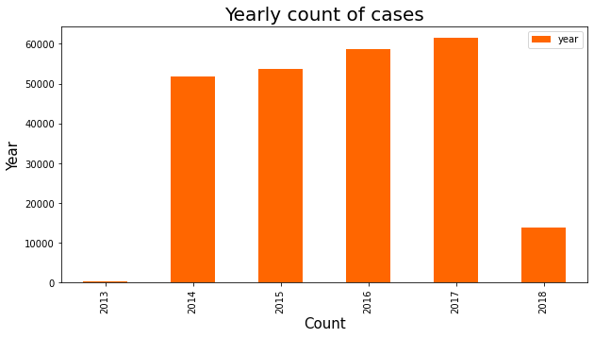
Number of gun violence per year
Violence is increasing with the year.
The data available for year 2018 is only for 3 months so we can ignore the data

Slide 9
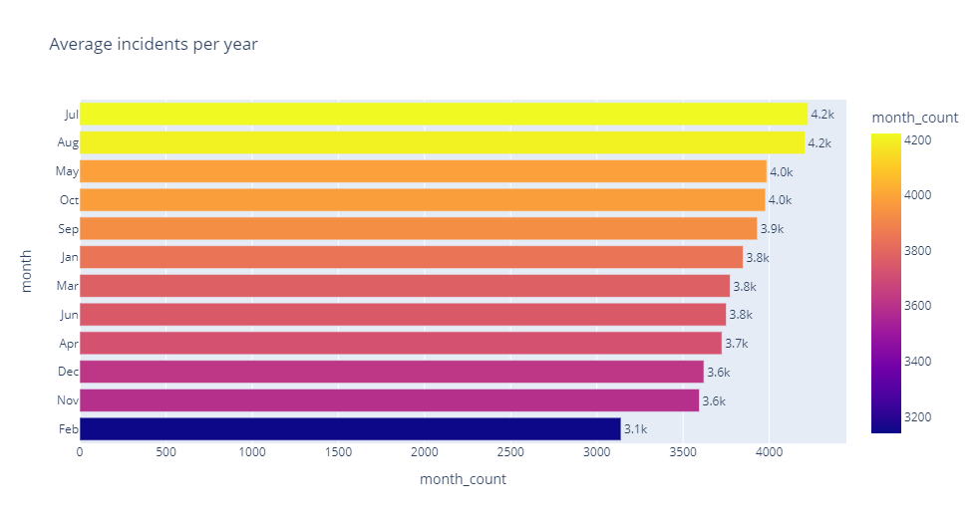
Incidents per month for every year
The month of July and august has around 4.2k incidents
Whereas February has the least number of incidents around 3.1k every year

Slide 10
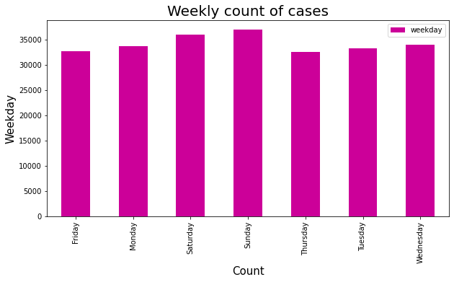
Average number of gun violence per week
gun violence incidents are higher on weekends with approximately 35k+ incidents
Saturday and Sunday seems to be most violent days

Slide 11
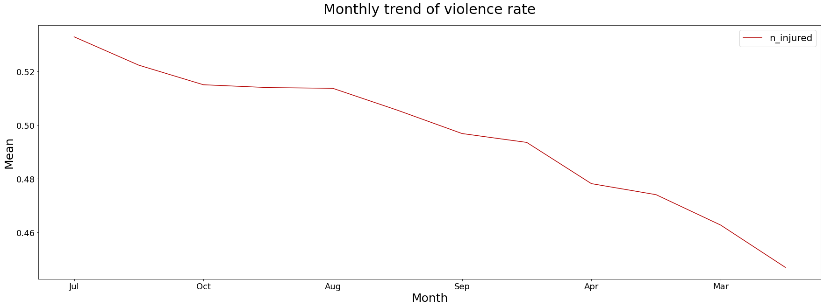
Trend of the violence rate per month
July seems to be most violent month as July 4th is celebrated as the Independence Day in United States of America

Slide 12
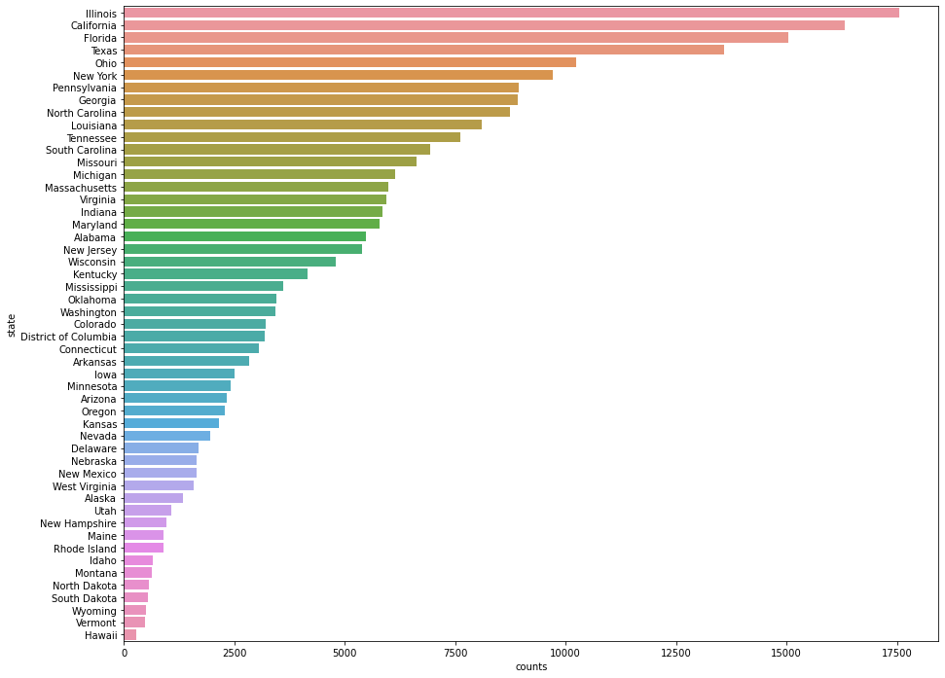
Number of incidents by every state
The data reveals that
Illinois, California, Florida, Texas, Ohio, New York are the states with very large rate of violence
While Hawaii is the one with least violence

Slide 13
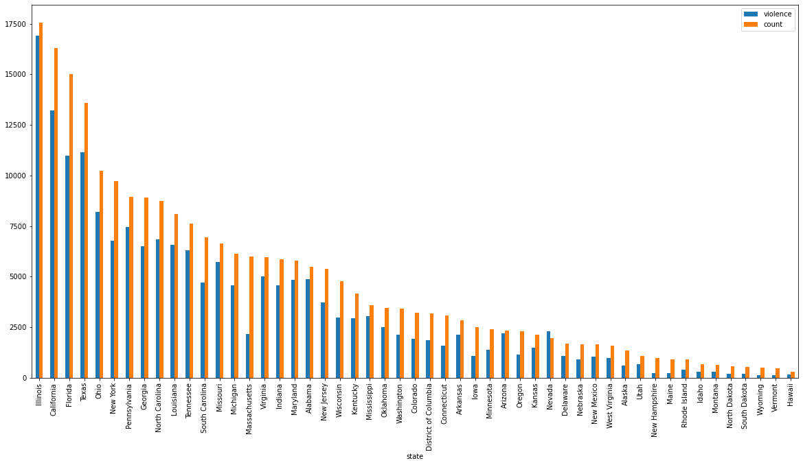
Incident happened vs violence level
From this analysis we can see that Illinois is more violent than any other state as the number of incidents vs violence is very close to each other

Slide 14
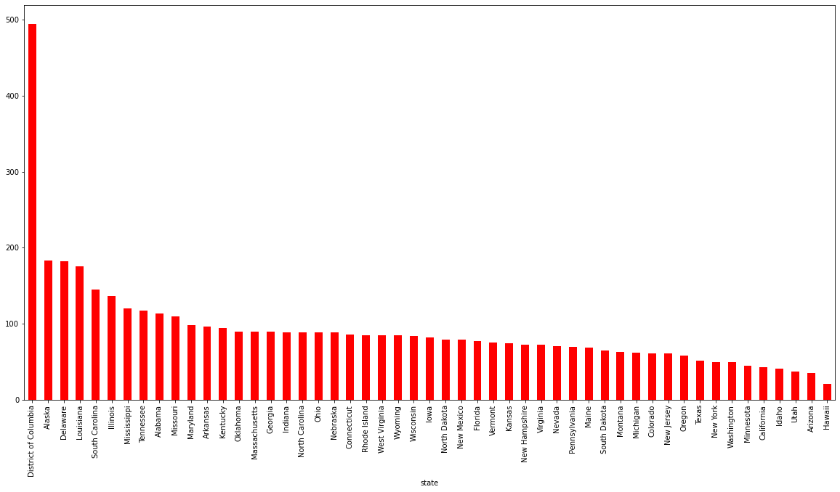
Incidents per 100k by state
District of Columbia and Alaska has the highest number of gun violence incidents per 100,000 people approx. while Arizona, Utah, and Idaho are the states with least number of incidents in population adjusted dataset.

Slide 15

Common Areas of Gun Violence Incidents
As we can see here
High School, Apartment, Parks, Gas Station, Walmart, Motel, Bar, Club are very violent

Slide 16


Common months and days of gun violence incidence
Saturday, Sunday, Monday and Wednesday are the days that comes most in the violence.Jan, Aug, Mar, Jul are the most violent months
Why those months are most violent ?
we can observe the highest peaks around July 4th and July 5th every year from 2014 to 2017. This is very interesting as July 4th is celebrated as the Independence Day in United States of America From this data, it seems that 4th July - 5th July are the dates related with very large number of gun violence incidents, hence are the most dangerous dates The holiday can also contributes to the fact that large number of gun violence incidents are reported.

Slide 17
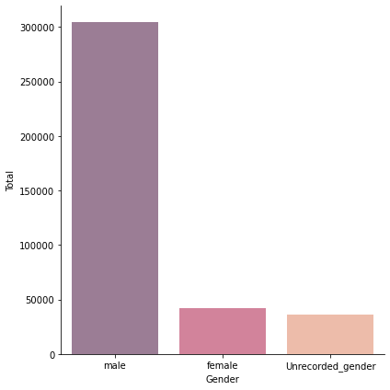
Participants Gender and Type visualizations and insights.
From the data we can observe that males are 6.5x more involves in the violence. While we still have genders which are not recorded

Slide 18
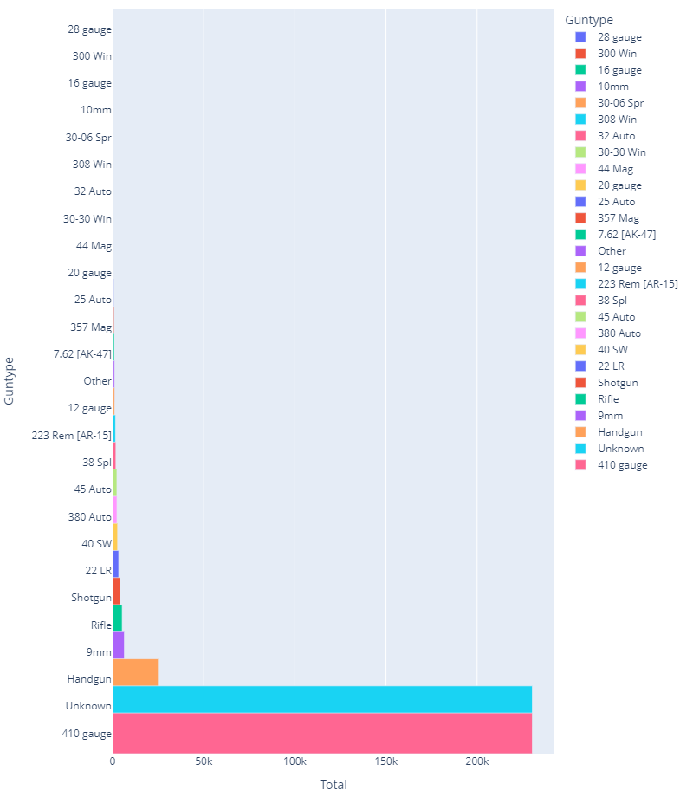
Analysis of types of guns used in the gun violence
From the visualization and the output above it is evident that the type of guns used mostly are unknown not recorded followed the 410 gauge used. The gun that is least used is the 28 gauge type.

Slide 19
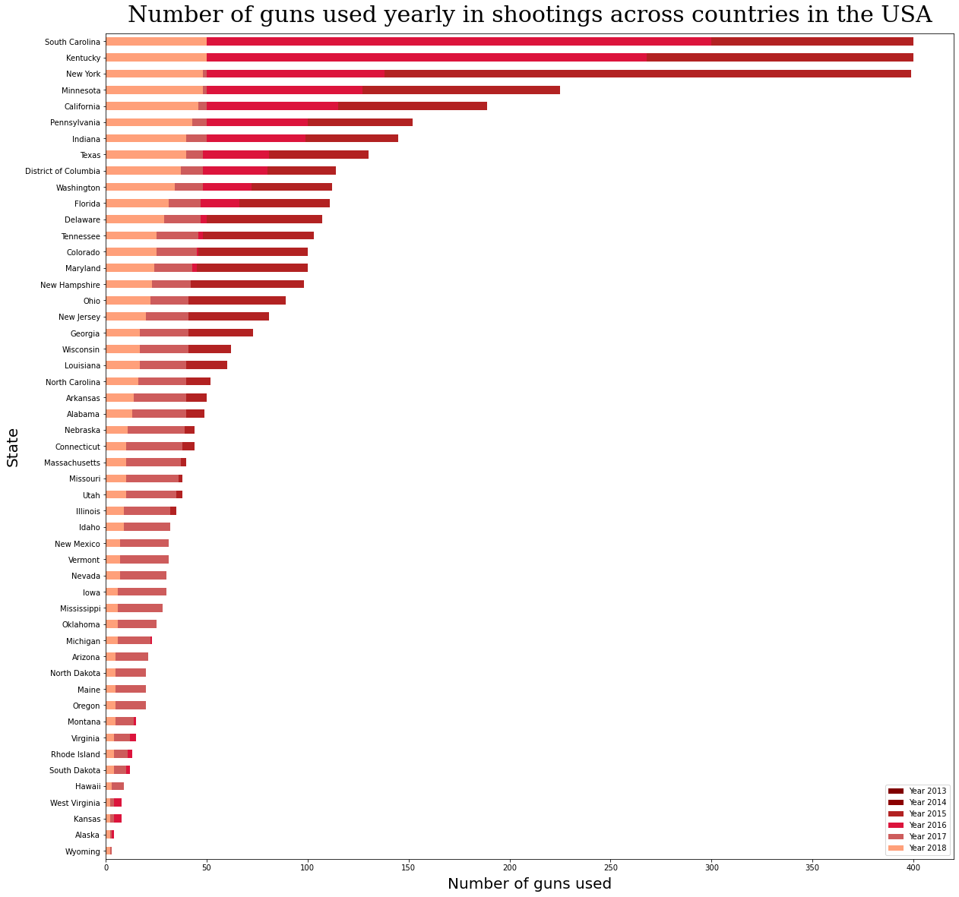
Number of guns used in incidents
In South Carolina ,Kentucky and New York has Number of guns used yearly in shootings across countries in the USA.
While Kansas, Alaska, Wyoming are the safest ones

Slide 20
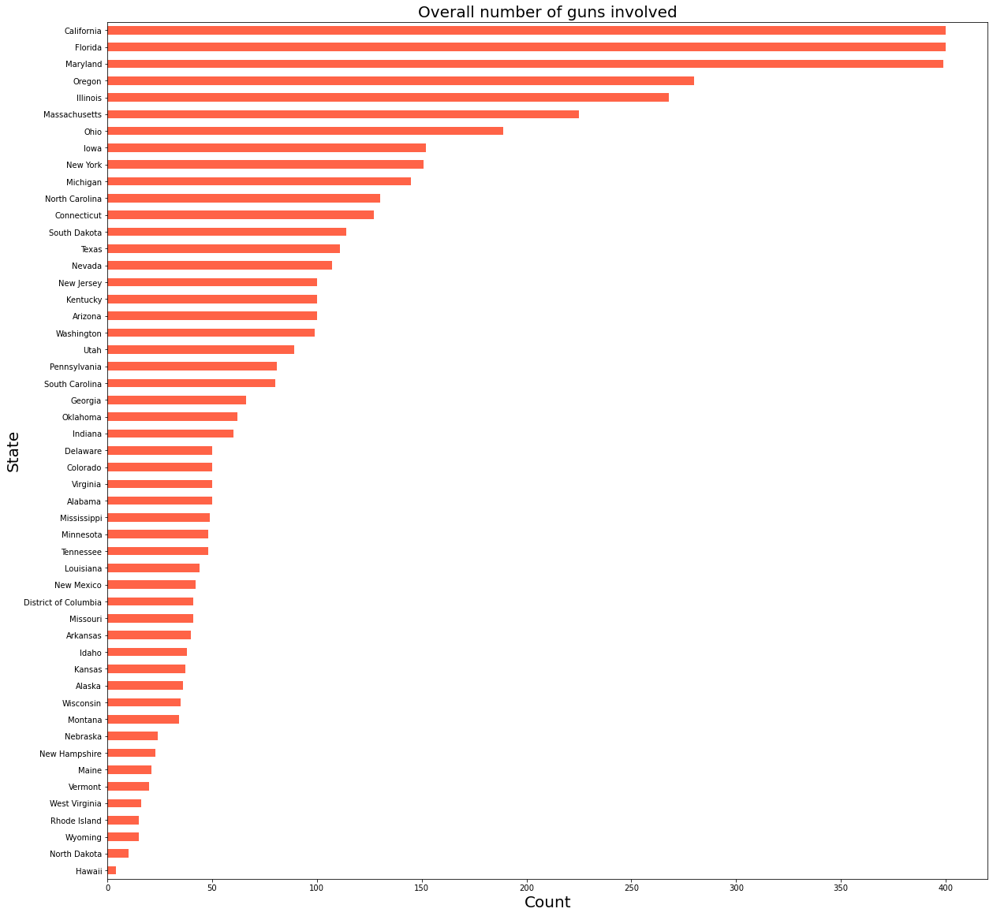
Overall number of guns involved
But in overall California, Florida and Maryland comes on the top for Overall number of guns involved.
While Hawaii is the safest to explore.
This is interesting as now we can go to Hawaii for weekends as during the weekends there is more violence in the city

Slide 21
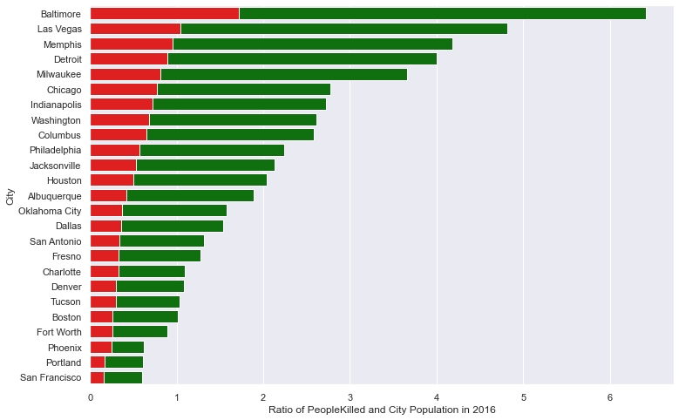
Incidents per 100k by city
Baltimore, Las Vegas and Memphis comes on the top for Ratio of People Killed and City Population in 2016

Slide 22
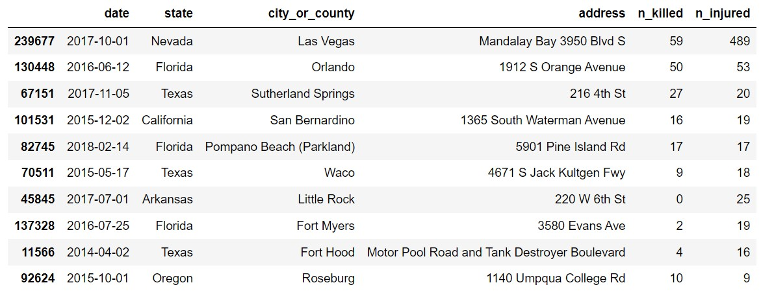
Most Serious Gun Violence Incidents
we can conclude that in Las Vegas, Orlando, Sutherland Springs has most number of deaths happened so far due to gun violence

Slide 23
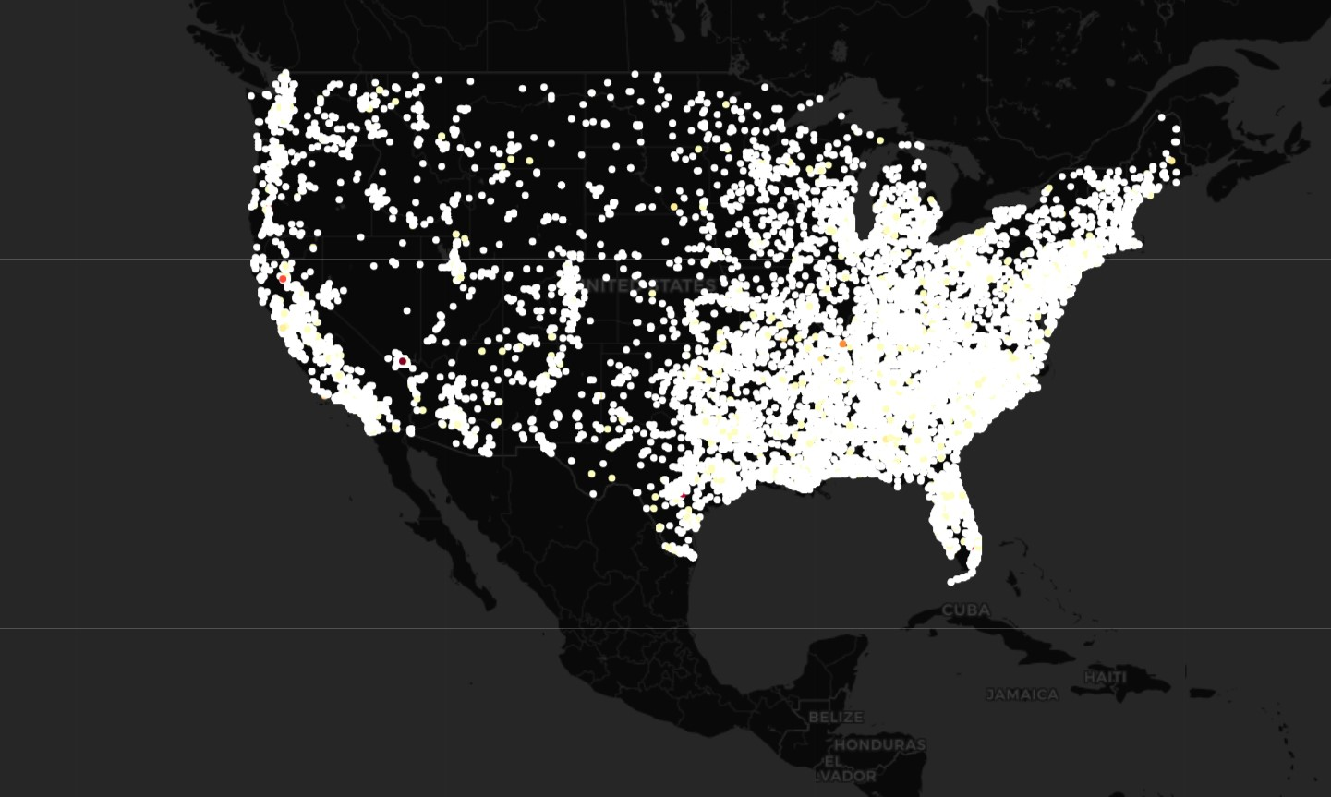
Here are the visuals for the violence of incident

Slide 24
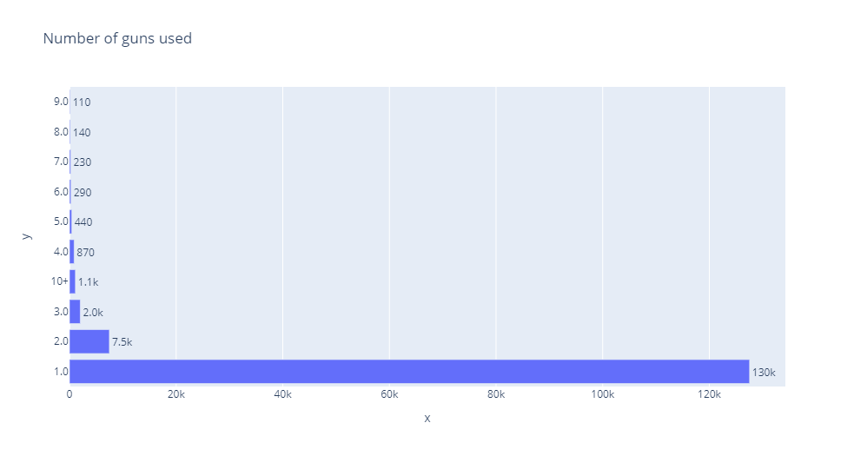
Number of guns involved per incident
Single gun is used the most during the gun violence

Slide 25
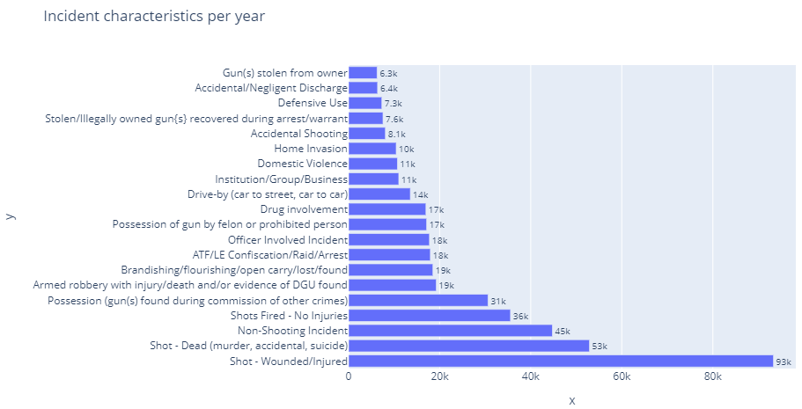
Incident characteristics per year
Participants are trying to make it violent by just leaving a person without killing them this means that they intentionally wants to create the violence
In the USA around 17k incidents were of Drug involvement

Slide 26
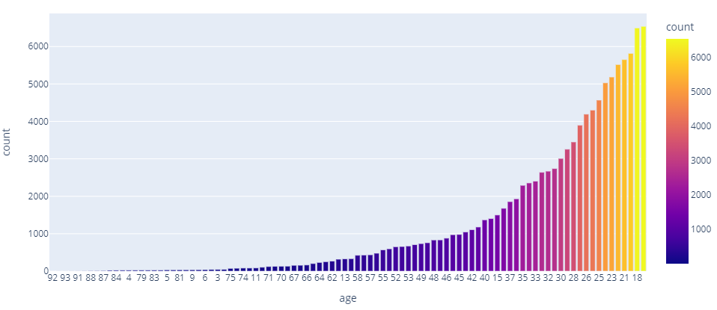
Age wise involvement of participants
Participants from the age group 18,19,20 till the age 25 are most involved in the violence this is the reason that there is a rise in lack of profitable employment.

Slide 27
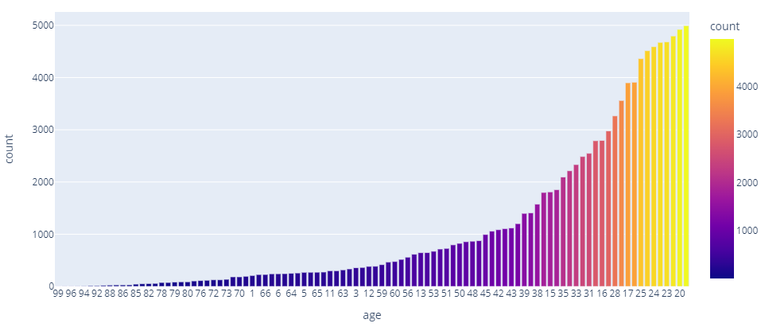
Age wise involvement of victims
They are killing the same age group while the childrens below the age of 15 are getting killed. Also the newly born childs below the age of 5 are getting killed.
This is extreme

Slide 28
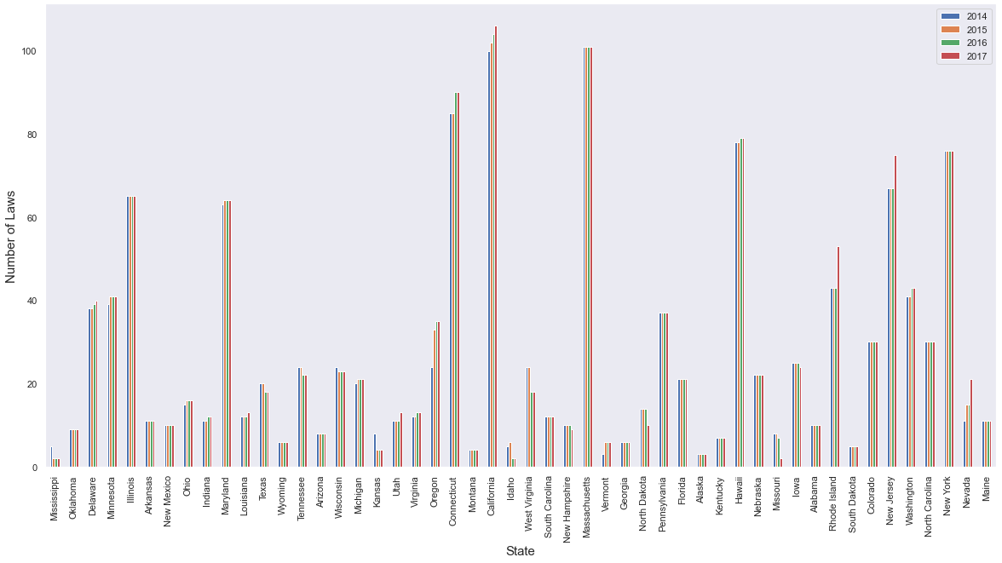
Year wise review of laws
This are quite insights
Government is taking action towards those incidents in the California we can see that year wise there is growth in the laws. Which is the proof of strictness in terms of security of the people

Slide 29
Conclusions
Gun violence activities have high occurrences during the weekends. This maybe related to the fact that most people are at home or out at leisure Park. This also confirms the analysis that gun violence activities mostly occurs at personal apartments and Parks.
More of the participants in gun violence are male.
Illinois represents the most violent state.
The month of July represent the most violent month and specifically a peak occurs between 4th and 5th July. This period coincidence with the National Holiday. It is presumable that the National Holiday has a effect on gun violence.
The age bracket of participants and victims in these violence are between 18 and 25. These age group represents the population of the country most hit by unemployment. Therefore unemployment can be regarded as one of the causes of rising gun violence.
There is a high portion of the participants as male. Which suggest that a gun violence incident is more likely to be a male.
There should be increased security vigilance during the holidays and weekends.
Unemployment is a major cause of the gun violence activities, an increase in profitable employment can reduce the rate of violence.

Slide 30
Thank you !!

